Slide 1
Adverse Health Effects associated with Frailty among CKD patients
20180915
Patrick Yihong Wu
總之主要就是要討論在CKD病人中frailty會造成什麼樣的負面健康影響。
Notes:
Under CKD
Frailty’s relation with (adverse health effect) ABCDE….
心理因素?
下次要整理出表！包含Risk ratio

Slide 2
Thoughts
闡述關係：
Frailty – comorbidities
Frailty – mortality
Comorbidities – mortality

Slide 3
Questions
CKD’s relation with C-reactive protein, microalbuminuria, COPD, 25 hydroxy vitamin D (average sample serum level = 29.38; normal = ?), bicarbonate (average sample serum level = 27.62; normal = 23-30)
Mediator of frailty?
Results?
Signs?
Complications? Comorbidities?

Slide 4
Big Chart
 | Related adverse health effects |  | RR/OR/HR/p-value in reference
Frailty Among CKD Patients | Sarcopenia
 | Physical comorbidities | CVD
 |  | CHF
 |  | HTN, CVA, LVD, PVD, smoking, IDH, Kt/V, serum creatinine, and hemoglobin | Yadla, John, & Mummadi, 2017: RR 1.1-1.5
 |  | Uraemia
 | Biochemical | Acidosis (inducing sarcopenia [caspase-3 and the ubiquitin proteasome system, inhibits intracellular signalling of insulin and IGF-1 and increases adrenal glucocorticoid production] and pain + itch [ASIC3 and TDAG8]) ***到底怎麼決定哪些因子是cause哪些是effect??生統有教，但是文獻看不太出來。 | Wilhelm-Leen, Hall, M, & Chertow, 2009: (We further adjusted for comorbid conditions that we had hypothesized to be related to frailty (diabetes, arthritis, cancer, chronic liver disease, and chronic lung disease) but not caused by chronic kidney disease.) (In subsequent analyses, we also adjusted for factors that often complicate chronic kidney disease to potentially explain any association identified between chronic kidney disease and frailty. These factors included sarcopenia (estimated using bioelectrical impedance analysis parameters), anemia (hemoglobin concentration), acidosis (serum bicarbonate concentration), inflammation (C-reactive protein concentration), vitamin D deficiency, and overt cardiovascular disease, as described above.) Nixon et al., 2017: Acidosis是sarcopenia以及frailty的key contributor
 |  | Inflammatory chemicals
 | Psychosocial | Mood | The Emonton Frail Scale (Orlandi & Gesualdo, 2014)
 |  | Good interaction with family | Interview (Moffatt, Moorhouse, Mallery, Landry, & Tennankore, 2018)
 |  | Cognitive impairments | McAdams-DeMarco et al., 2015: p ≦ 0.05
 |  | Depression (Beck dep. scale) | 幾乎都當作是平行存在，需要消除的因子
 |  | HRQOL | Soni, Weisbord, & Unruh, 2010: Narrative only Kanauchi, Kubo, Kanauchi, & Saito, 2008: between frail and non-frail p ≦ 0.001 (Persons ≧ 75 years old and those with depressive mood or lower creatinine clearance had significantly lower WHOQOL-26 scores than their counterparts.)
 | Other adverse effects | Nosocomial infections | Heuberger, 2011: RR = 2.1, 1.1–3.8, p < 0.001 (in frail, further increase with cancer)
 |  | Viral infection - HCV | Yadla, John, & Mummadi, 2017: P = 0.04 (Frailty in those with serological infections due to hepatitis B and hepatitis C was found in 14/15 patients and 36/37 patients, respectively (P = 0.31 and P = 0.004).)
 |  | Hospitalization
Notes:
一個subtype下的文獻數量盡量不要超過三
超過三就分開，例如CVD包含一堆東西，分開講
reference放最後面，前一排放Value

Slide 5
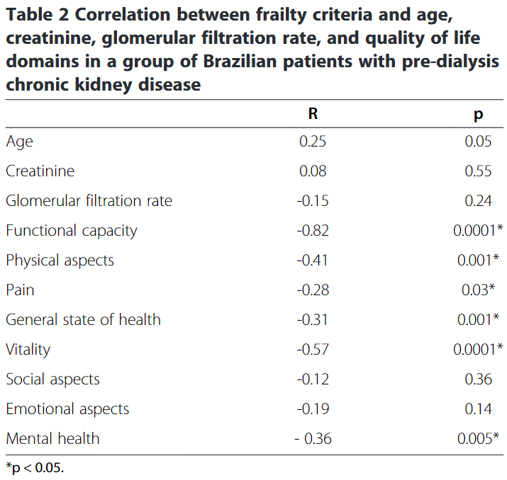
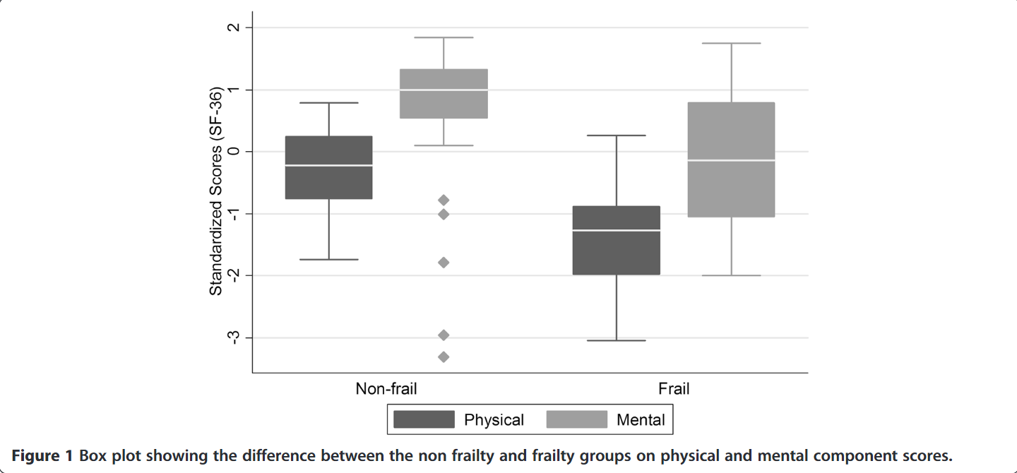
Summary
Reference | Group/Method | Probable Comorbidities
Mansur, H. N., Colugnati, F. A., Grincenkov, F. R., & Bastos, M. G. (2014). Frailty and quality of life: a cross-sectional study of Brazilian patients with pre-dialysis chronic kidney disease. Health Qual Life Outcomes, 12, 27. doi:10.1186/1477-7525-12-27 | Braziliens with pre-dialysis CKD / Cross-sectional study Criteria of frailty: Johansen’s et al. criteria (Johansen LK, Chertow GM, Jin C, Kutner NG: Significance of frailty among dialysis patients. J Am Soc Nephrol 2007, 18:2960–2967. ) | 切中要點 When separated according to physical and mental scores, frail patients performed more poorly. In addition, there were correlations between frailty and QOL domains, excluding indices of social functioning. (excluding indices of social functioning表示沒有social functioning參與其中) 論文中有提到baseline中何者為frailty的variables要用chi-square 尋找相關係數用multiple variable regression或independent variable???

Slide 6
Summary
Reference | Group/Method | Probable Comorbidities
Hartmann, E. L., Kitzman, D., Rocco, M., Leng, X., Klepin, H., Gordon, M., . . . Kritchevsky, S. (2009). Physical function in older candidates for renal transplantation: an impaired population. Clin J Am Soc Nephrol, 4(3), 588-594. doi:10.2215/CJN.03860808 |  | 沒用，非CKD底下frailty與負面健康狀況相關的文章 Older people referred for renal transplantation had poorer physical performance than older adults with other common chronic diseases and may be at high risk for disability while awaiting transplantation. 參考文獻也都沒有專門討論CKD中的frailty

Slide 7
Heuberger, R. A. (2011). The Frailty Syndrome: A Comprehensive Review. Journal of Nutrition in Gerontology and Geriatrics, 30(4), 315-368. doi:10.1080/21551197.2011.623931
McAdams-DeMarco, M. A., Tan, J., Salter, M. L., Gross, A., Meoni, L. A., Jaar, B. G., . . . Sozio, S. M. (2015). Frailty and cognitive function in incident hemodialysis patients. Clinical Journal of the American Society of Nephrology, 10(12), 2181-2189.
Moffatt, H., Moorhouse, P., Mallery, L., Landry, D., & Tennankore, K. (2018). Using the Frailty Assessment for Care Planning Tool (FACT) to screen elderly chronic kidney disease patients for frailty: the nurse experience. Clinical interventions in aging, 13, 843.
Nixon, A. C., Bampouras, T. M., Pendleton, N., Woywodt, A., Mitra, S., & Dhaygude, A. (2017). Frailty and chronic kidney disease: current evidence and continuing uncertainties. Clinical kidney journal, 11(2), 236-245.
Orlandi, F. d. S., & Gesualdo, G. D. (2014). Assessment of the frailty level of elderly people with chronic kidney disease undergoing hemodialysis. Acta Paulista de Enfermagem, 27(1), 29-34.
Soni, R. K., Weisbord, S. D., & Unruh, M. L. (2010). Health-related quality of life outcomes in chronic kidney disease. Current opinion in nephrology and hypertension, 19(2), 153.
Wilhelm-Leen, E. R., Hall, Y. N., M, K. T., & Chertow, G. M. (2009). Frailty and chronic kidney disease: the Third National Health and Nutrition Evaluation Survey. Am J Med, 122(7), 664-671 e662. doi:10.1016/j.amjmed.2009.01.026
Yadla, M., John, J. P., & Mummadi, M. (2017). A study of clinical assessment of frailty in patients on maintenance hemodialysis supported by cashless government scheme. Saudi Journal of Kidney Diseases and Transplantation, 28(1), 15.

